Slide 1


Slide 2
Image classification using Convolutional Neural Networks (CNNs) for the "Plants Classification" dataset.
Group Members:
Gudisinti Durgaprasad (Gd299)
Sai Nikhil Dunuka (Sd2279)
Yashwanth Reddy B (Byr3)
Harshith Gade (Hg355)

Slide 3
Index
Intro & Problem statement
About Dataset
Data Preparation
Model Selection and Approach
Findings and Results
Model Evaluation Comparison
limitations
Future Work

Slide 4
Introduction & Problem Statement
we aim to build a deep learning model that can automatically classify different species of plants based on their images.
To achieve this, we will use Convolutional Neural Networks (CNNs), a type of deep learning model designed for analyzing visual data.
Objective :
To Build a robust image classification model capable of identifying plant species using deep learning techniques.
Compare different pre-trained models (ResNet50, InceptionV3) and custom CNNs to identify which model performs the best for plant classification.
Evaluate the performance of these models using accuracy, precision, recall, and other metrics.

Slide 5
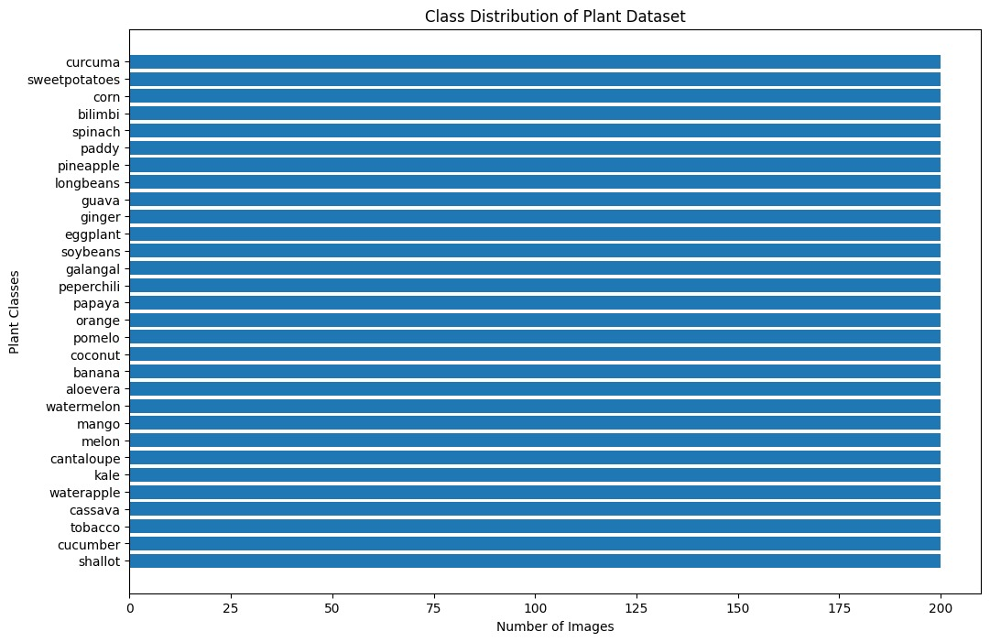
About dataset
Source: The data set is obtained from Kaggle
Classes: The dataset contains 30 types of plants images with a total data size of 1.48GB, and supports the recognition of the following plant classes as shown in the class distribution of the plant dataset .
Data Set Link: https://www.kaggle.com/datasets/marquis03/plants-classification/data

Slide 6
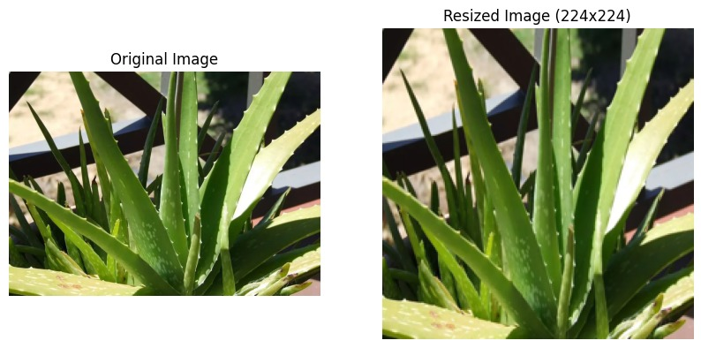
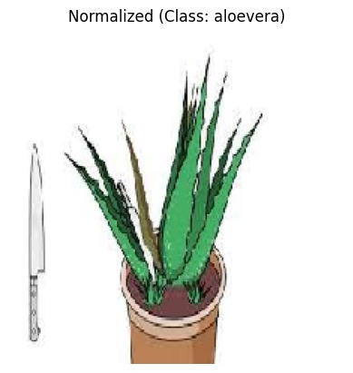
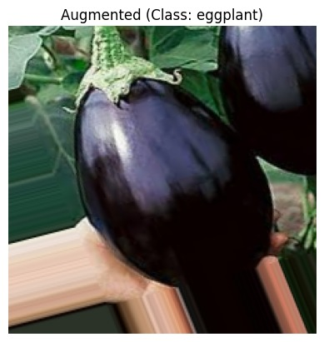
Data Preprocessing
Resizing: All images are resized to 224x224 pixels, which is a standard size for the models used in this project.
Normalization: The pixel values are normalized to the range of [0, 1] by dividing by 255 to improve model training efficiency.
Data Augmentation: Techniques like rotation, zoom, flipping, and shearing are used to increase the variety of training data and help prevent overfitting.

Slide 7
Model Selection and Approach
CNN: | A simple CNN architecture designed and trained from scratch to classify plant species. It uses basic convolutional layers followed by pooling and fully connected layers.
ResNet50: | A deep Convolutional Neural Network (CNN) with Residual Blocks that helps prevent the vanishing gradient problem, making it suitable for deeper networks. Pre-trained weights from ImageNet were used, and the top layer was modified for plant classification.
InceptionV3: | A deep CNN with an architecture that uses inception modules, which combine multiple filter sizes at each layer. It also uses pre-trained weights from ImageNet, modified for plant classification.

Slide 8
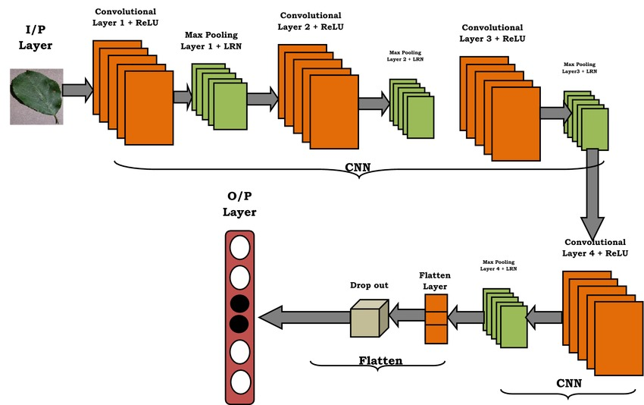
CNN Architecture
CNN architecture
 | Input Layer: Accepts plant images (e.g., 224x224 pixels). Convolutional Layers: Extract features (edges, textures) using filters. Activation (ReLU): Adds non-linearity, replaces negatives with zero. Pooling (MaxPooling): Reduces size, retains important features. Dropout: Applied after flattening to regularize the fully connected layers and prevent overfitting. Flatten Layer: Converts 2D maps to 1D vector for classification. Fully Connected Layers: Perform high-level reasoning and classification. Output Layer (Softmax): Converts logits into probabilities, classifies into categories.

Slide 9
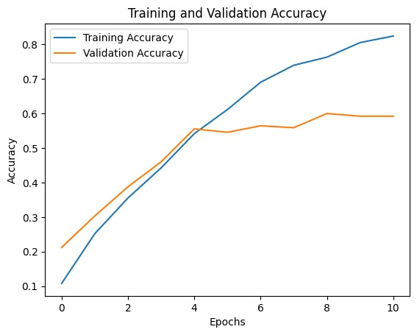
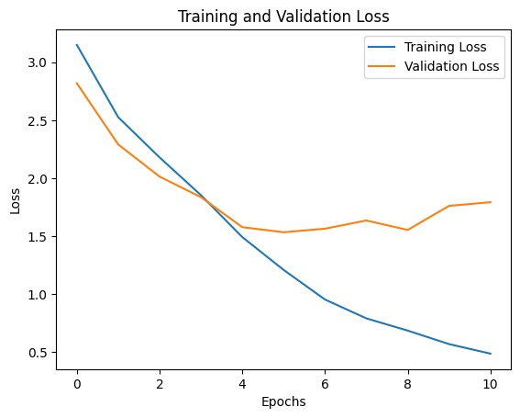
Findings and Results
L2 Regularization: We added L2 regularization to the convolutional and dense layers to penalize large weights and prevents the model from overfitting.
Increased Dropout: The dropout rate in the fully connected layer is kept at 0.5 to help regularize the model more aggressively.
Early Stopping: Early stopping is implemented to monitor the val_loss. If the validation loss does not improve for 5 epochs (patience=5), the training will stop.
Data Augmentation: We applied data augmentation to the training data, to generate more diverse images.

Slide 10
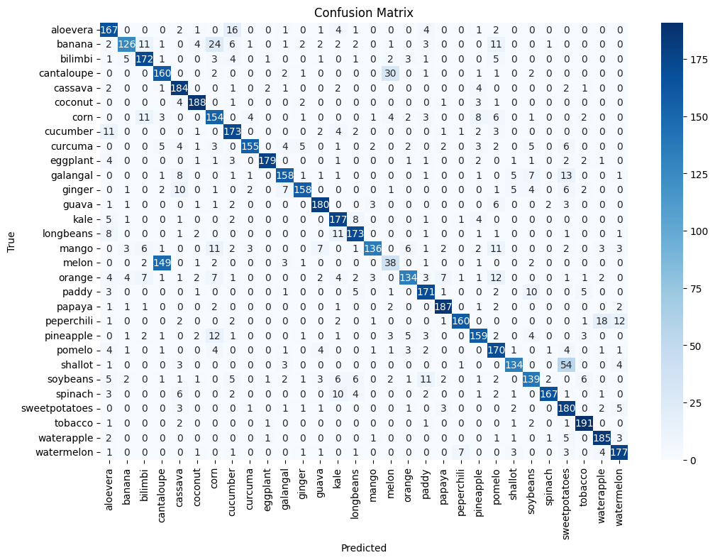
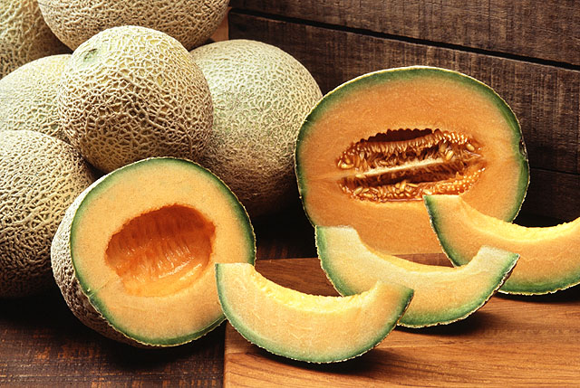
Key Issues with Cantaloupe Classification:
A large portion of cantaloupe samples is misclassified, primarily as: Melon (most common confusion).
Visual Similarity: Cantaloupe and melon likely have similar features (e.g., color, texture) that make them difficult for the model to differentiate.

Slide 11
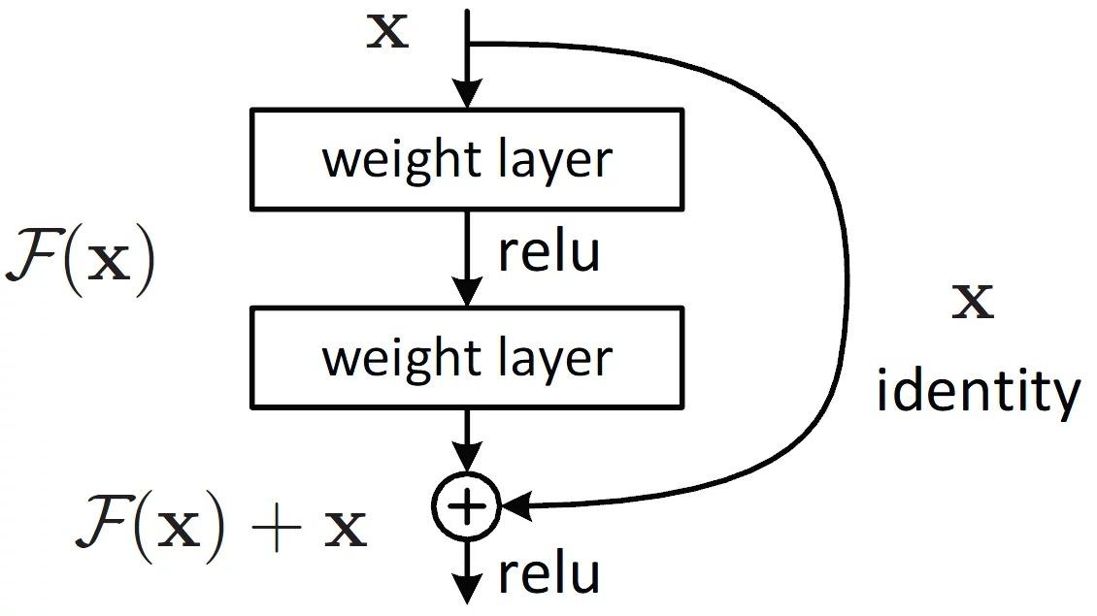
ResNet50 Architecture
50 layers with residual blocks to address vanishing gradient problem.
Residual connections (skip connections) allow gradients to flow easily, enabling deeper networks.
Building blocks: Convolutional layers (3x3 kernels), batch normalization, and ReLU activation.
Global Average Pooling (GAP): Reduces spatial dimensions before fully connected layer.
Fully connected layer: Softmax activation for multi-class classification.
Pre-trained on ImageNet: Helps in transfer learning for other datasets.
Benefits: Prevents overfitting, improves gradient flow, and enables training of deep networks efficiently.

Slide 12
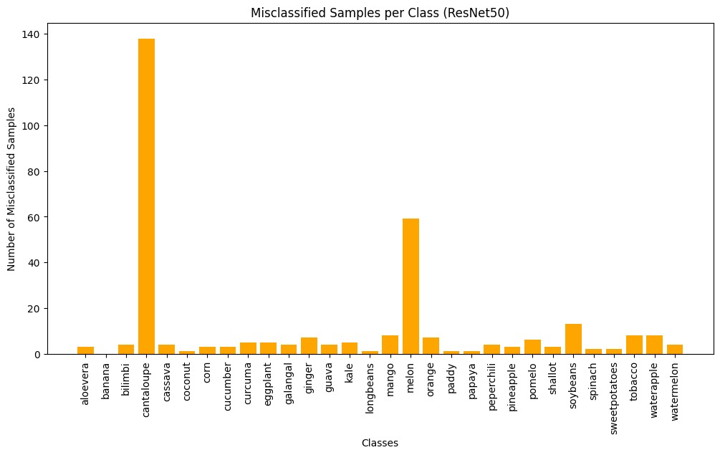
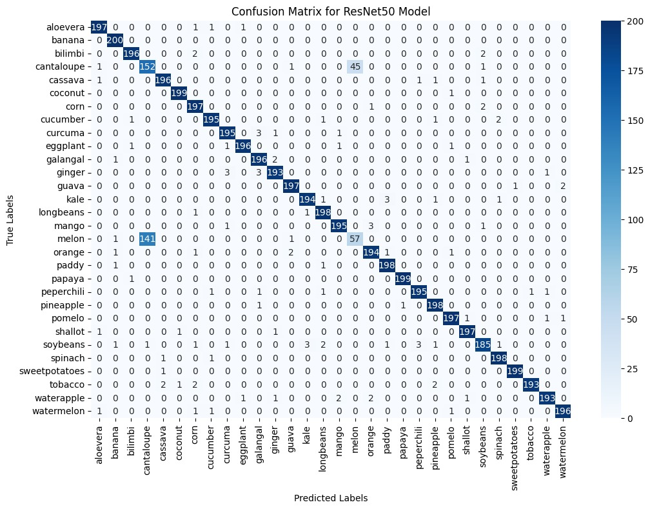
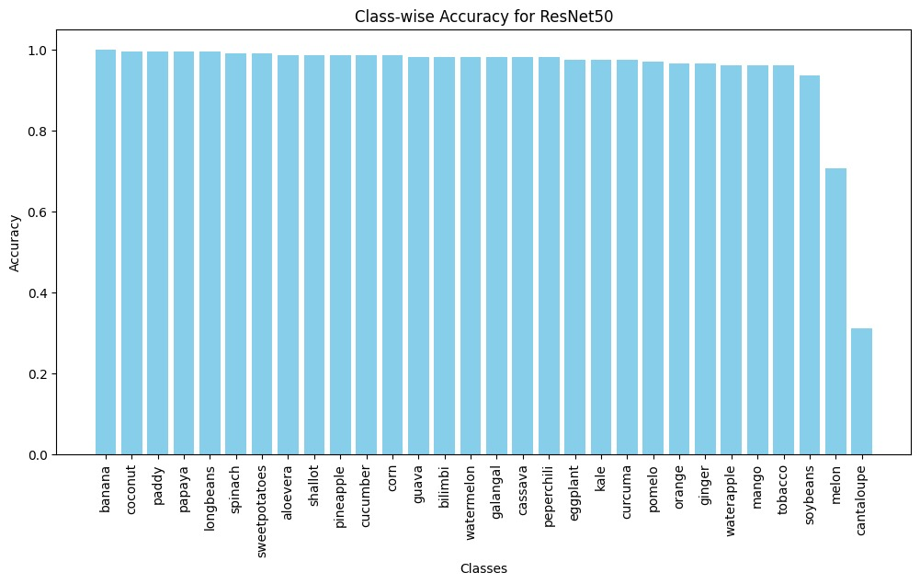
Findings and Results

Slide 13
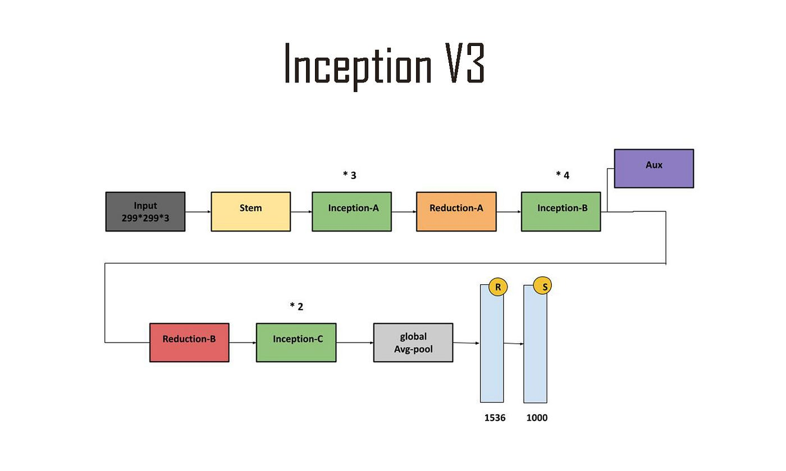
InceptionV3 Architecture
Multi-Scale Convolutions: Uses multiple filter sizes (1x1, 3x3, 5x5) to capture features at different scales.
Inception Modules: Combines features from different convolutions for richer representation.
1x1 Convolutions: Reduce parameters and computational cost via bottleneck layers.
Global Average Pooling: Replaces fully connected layers, reducing spatial dimensions.
Auxiliary Classifiers: Help with training by providing intermediate supervision.
Pre-trained on ImageNet: Leverages transfer learning for better performance.
Balanced Accuracy & Efficiency: Optimizes model complexity and computation

Slide 14
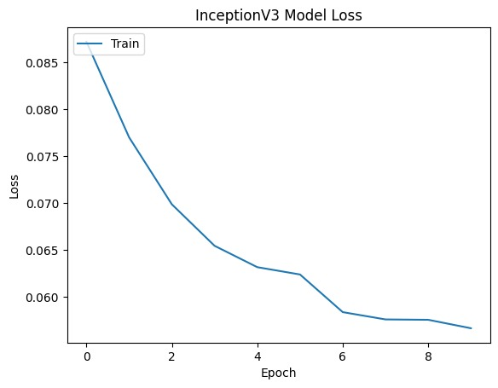
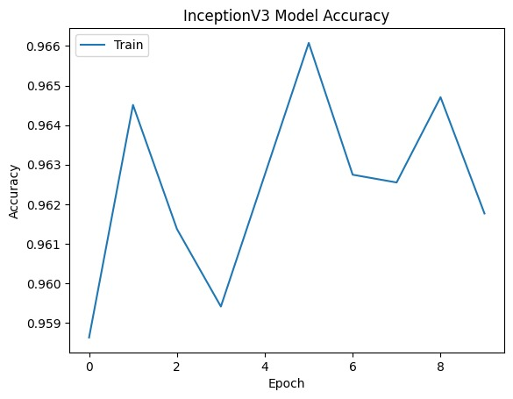
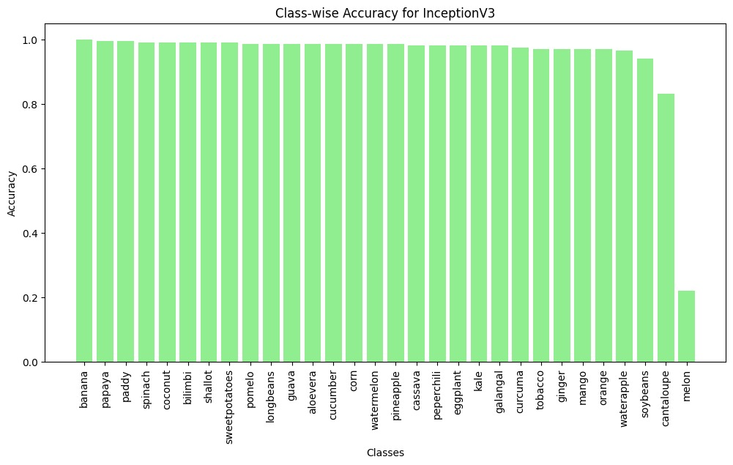
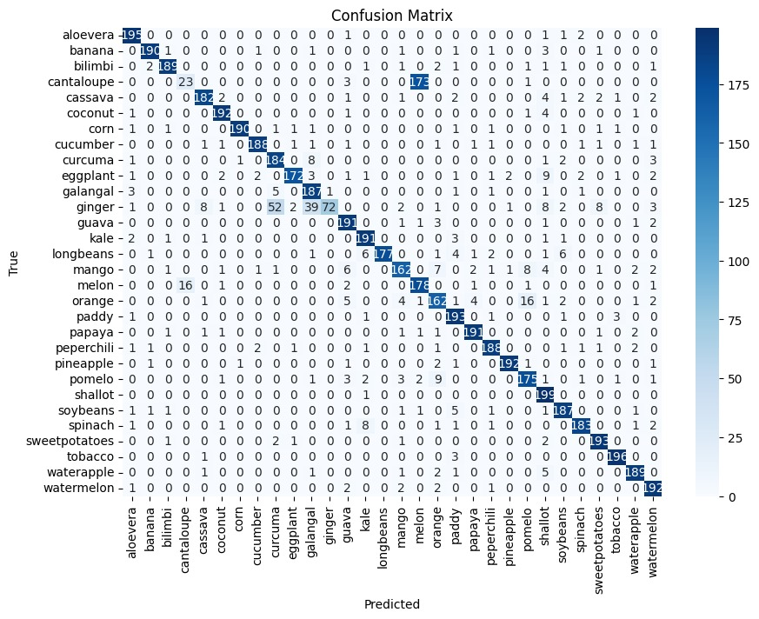
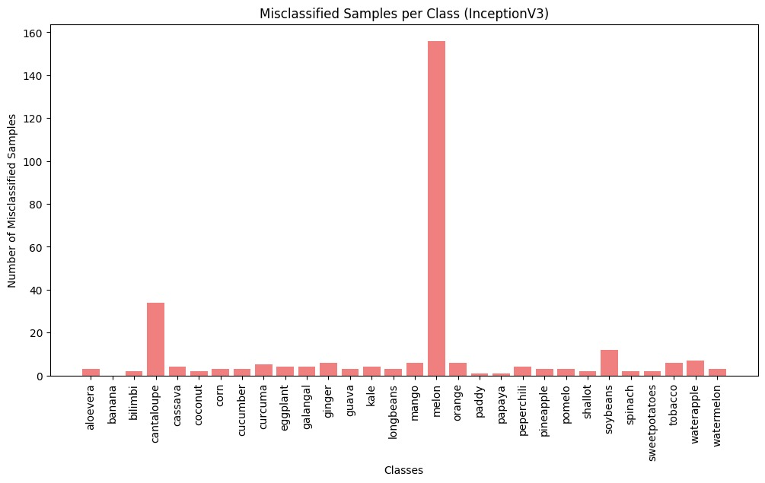
Findings and Results

Slide 15
Model Evaluation Comparison
Model | Accuracy | Precision | Recall | F1-Score
CNN | 80.53% | 0.81 | 0.81 | 0.80
ResNet50 | 90.25% | 0.95 | 0.95 | 0.95
InceptionV3 | 87.50% | 0.91 | 0.93 | 0.92

Slide 16
limitations
Confusion Between Similar Classes: As the training dataset doesn't have enough variations of each class (e.g., different types of melons or cantaloupes in various lighting conditions), the model struggled to distinguish between classes with similar visual features.
Models like ResNet50 and InceptionV3, while powerful, take a long time to train, especially with large datasets. This could be a limitation in real-time applications or environments where quick retraining is required.

Slide 17
Future Work
Increase Dataset Size:
Collect more images for underrepresented classes (such as cantaloupe and melon) to improve class balance and model generalization.
Advanced Augmentation Techniques:
Implement more sophisticated data augmentation strategies, such as color jittering, rotation, flipping, or even synthetic data generation, to further enhance model performance and robustness.
Fine-tune Pre-trained Models:
Unfreeze more layers of pre-trained models like ResNet50 and InceptionV3 to allow for more domain-specific learning, particularly for plant identification tasks.

Slide 18
THANK YOU

